Slide 1
Master’s Thesis: Nucleation of
lithium on different substrates
Gottfrid Olsson
2024-01-26

Slide 2
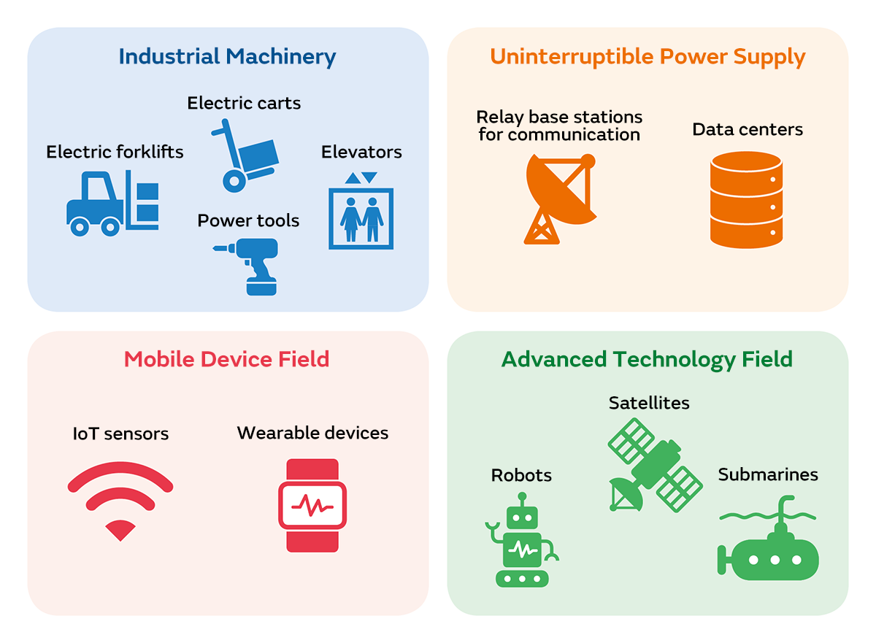
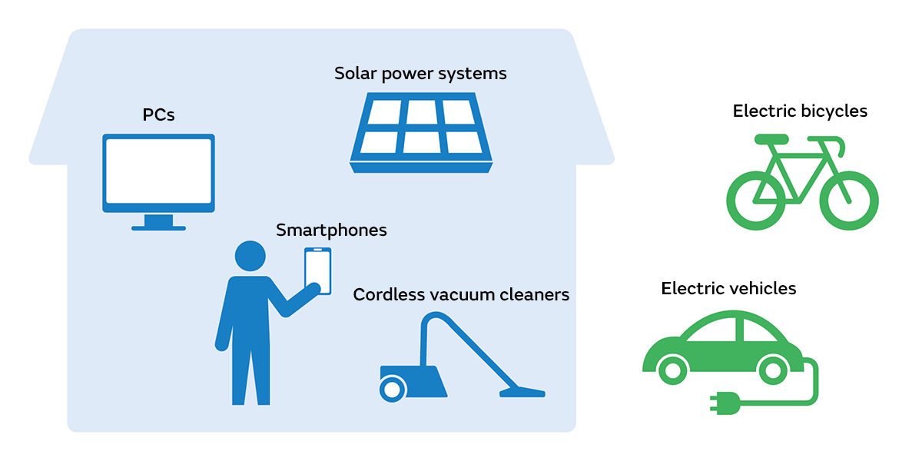
Background and motivation
Batteries are important!
Notes:
Batteries everywhere
Store and use energy
Li-ion battery popular

Slide 3
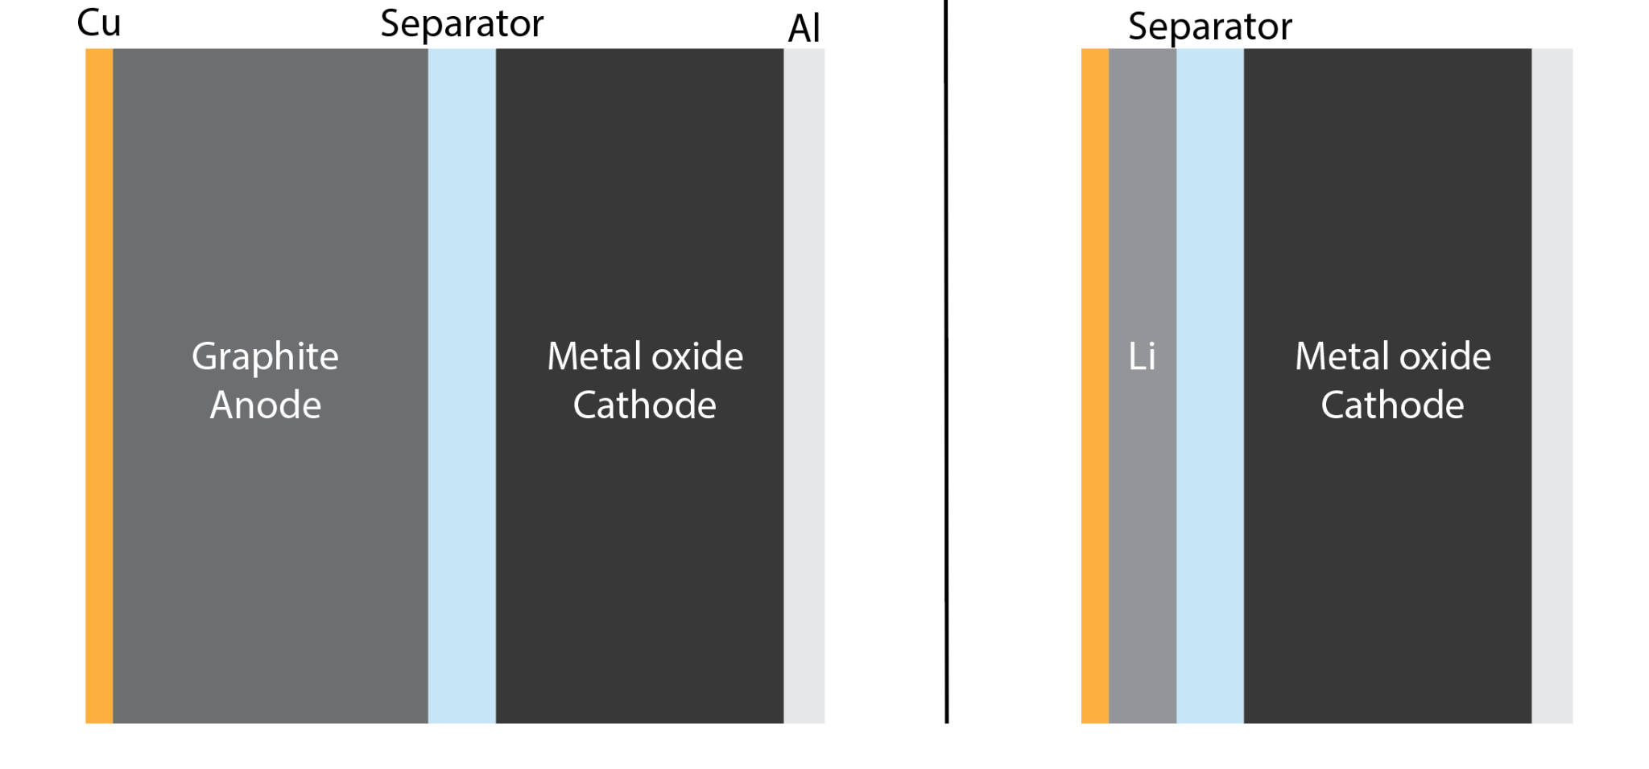
Background and motivation
Li-metal > graphite, but dendrite problems…
(3860 mAh g⁻¹ > 370 mAh g⁻¹)
Li-ion Li-metal
Notes:
Better batteries!
Replace graphite by Li-metal
But dendrites…
Understand how they form - know how to prevent

Slide 4
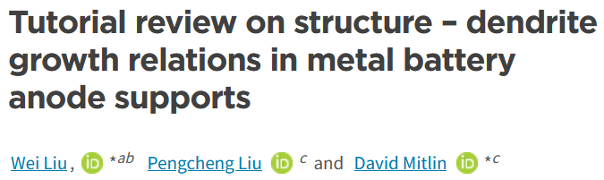
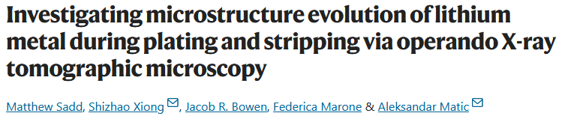
Background and motivation
Other works:
Notes:
have looked at different aspects of dendrites
nucleation and growth of Li on Cu
dendrite growth depends on change in enthalpy + nucleation overpotentials of different metals
operando: see growth

Slide 5
Purpose of this work
’’How does the
a) substrate,
b) current density, and
c) deposited areal capacity
affect the Li-nuclei size distribution?’’
Notes:
investigate nucleation for:
substrates, I and Q/A
other work have researched nucleation for different current densities and areal capacities for THE SAME substrate
this work aims to produce SEM images of nucleation for different substrates

Slide 6
What, exactly?
One common electrolyte
Different substrates
Different current densities
Different areal capacities
Build and cycle cells
Take SEM images
Notes:
investigate:
experimental work:

Slide 7
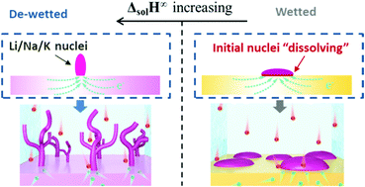
Substrates
Notes:
which substrates?
one article proposes DeltaH as an important factor

Slide 8
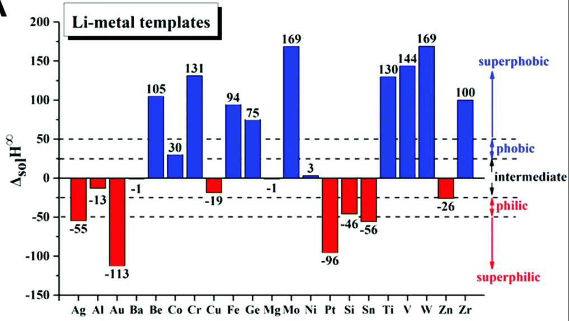
Substrates
W, Mo, Fe, Ti, …
Al, Cu, Mg, Ni, …
Ag, Au, Pt, Si, …
+ glassy carbon
Notes:
one superphobic (W, Fe, ..)
one intermediate (Al, Cu, Ni, …)
one superphilic (Ag, Pt, Si, …)
+glassy carbon (bcs Josef)

Slide 9
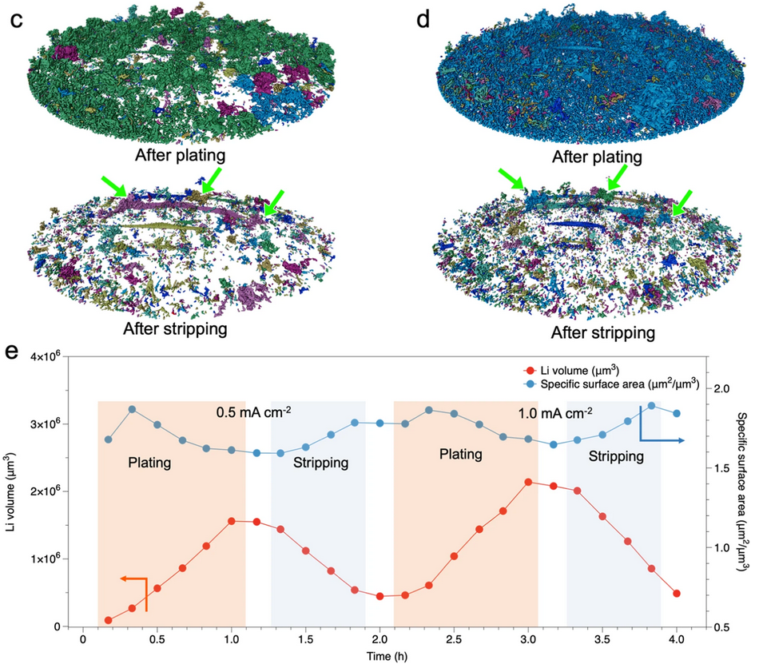
Current densities
Notes:
current densities 0.1 - 1.0 mA cm^-2

Slide 10
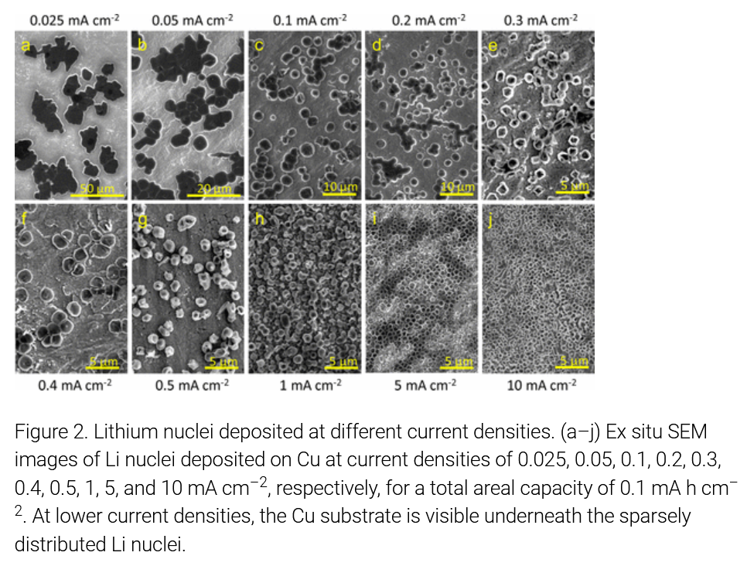
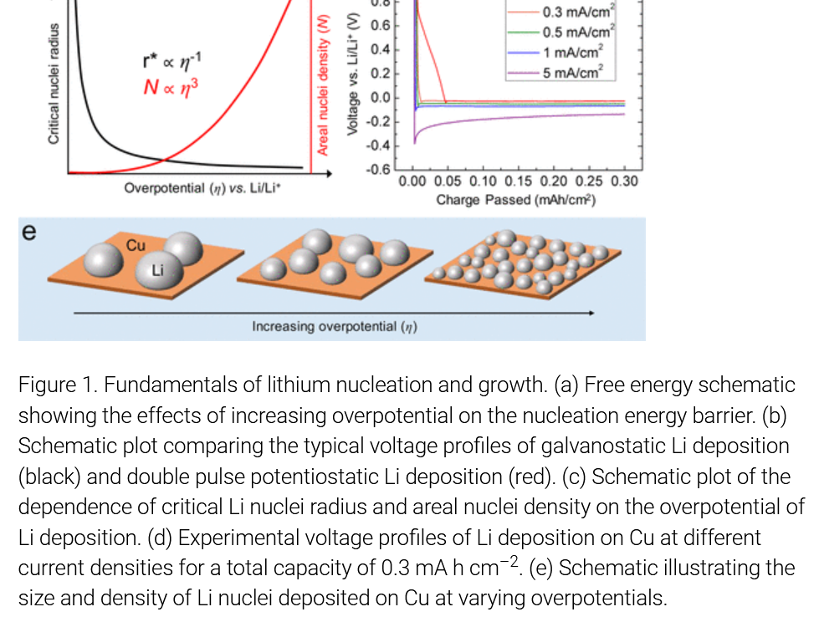
Areal capacities
Notes:
areal capacity: 0.1 - 1.0 mA cm^-2

Slide 11
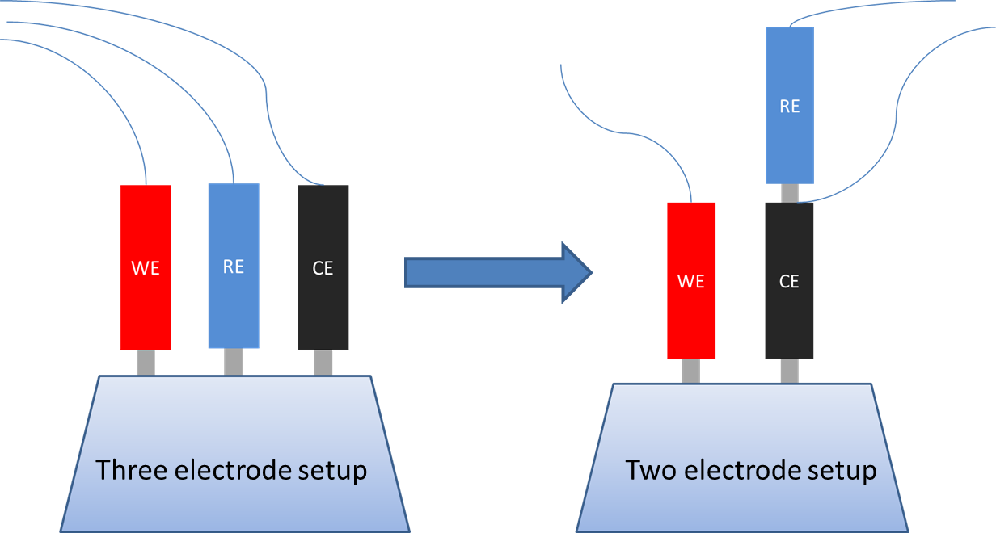
Experimental methods
Notes:
2: cycling
3: to separate voltage contribution of the two electrodes, e.g. for measuring overpotential for nucleation

Slide 12
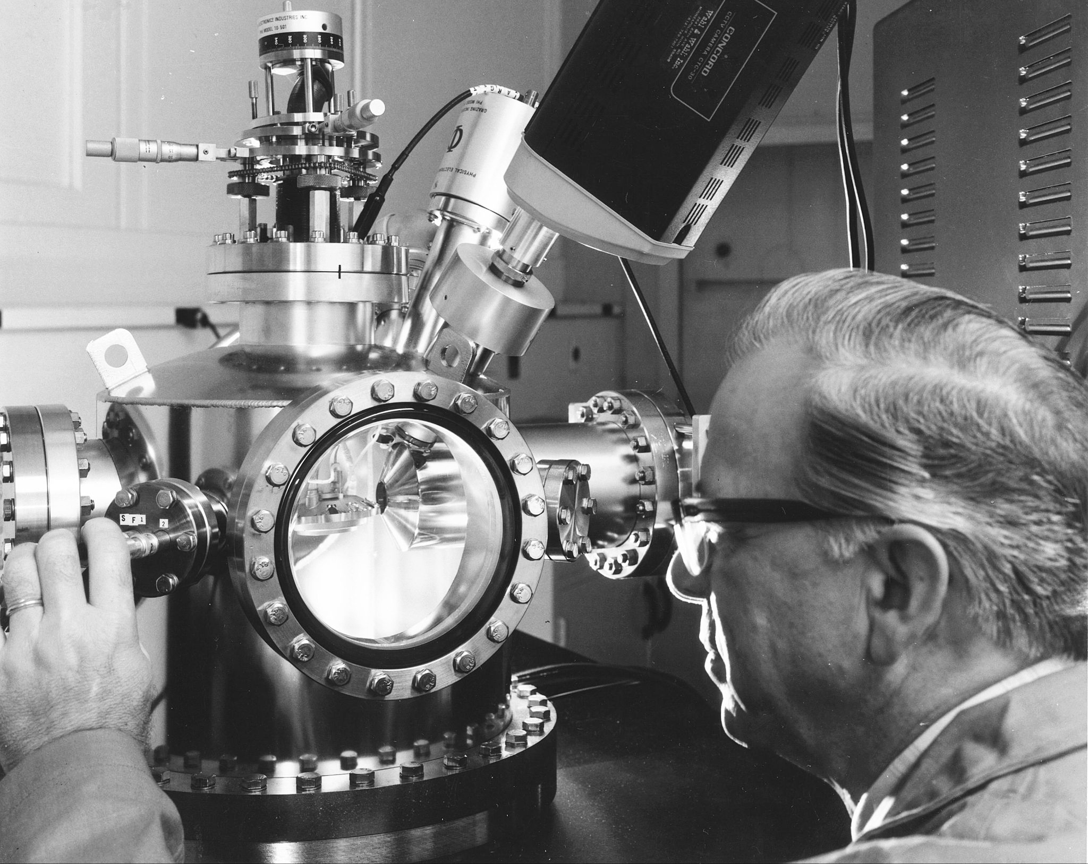
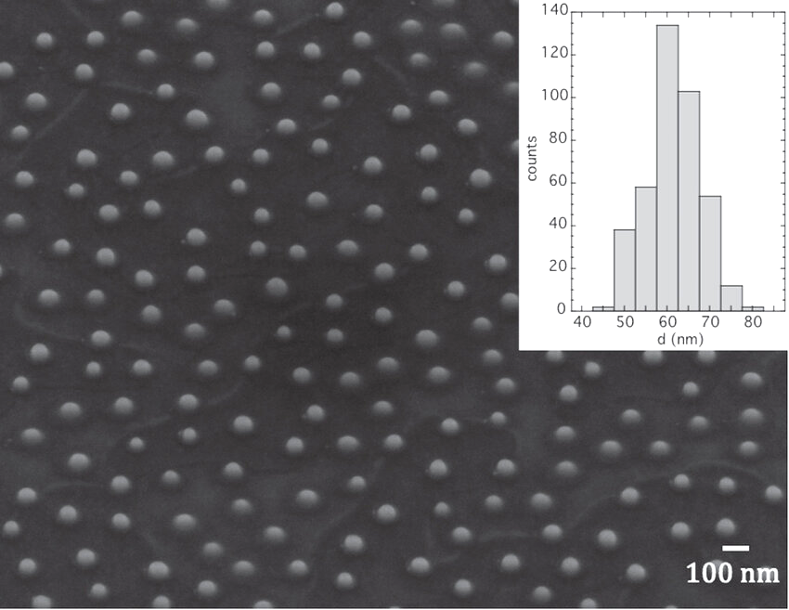
Experimental methods
Notes:
Auger electron microscopy
SEM image of nuclei
Analysis → histogram size distribution

Slide 13
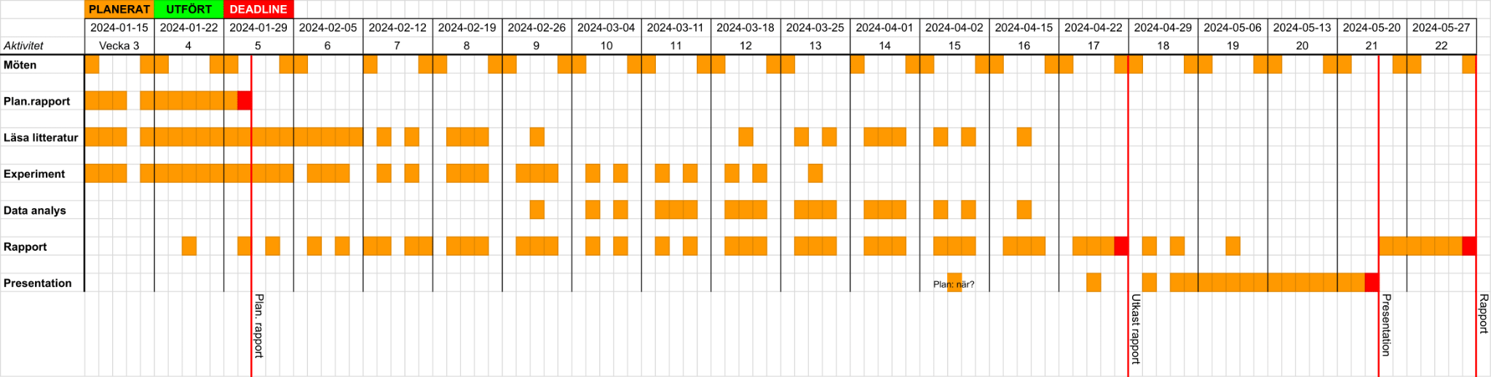
Time plan

Slide 14
Thank you!
Any comments or questions?

